Slide 1
Photo Description Generator
Ivanova Ekaterina
20198011

Slide 2
Introduction
My idea was to make a program that uses AWS Rekognition to describe a picture to a user.
The program will identify whether there is a person (or people) in the photo, describing their outward appearance, including their gender, age, facial expression, as well as what they are wearing. Apart from that, it will use the data to describe where the picture was likely taken – in other words, the scenery. After its analysis, the program will read the results out loud using AWS Polly.

Slide 3
How does it work?
A Java application that uses AWS Rekognition and Polly to create a short description of a given photo.
For determining if there are any people in the photo and details about them (including their genders, ages, moods etc.), Rekognition's Facial Analysis is used (function: describeFaces()). For determining people's clothes and their surroundings, Rekognition's Label Detection is used (functions: describeScenery() and describeClothes()).
These three functions generate the text that gets passed to function playFinalDescription(), which uses Polly to generate human-like speech.
An extremely simple Spring GUI is used for interface that lets a user search for a photo on their computer via a File Chooser.
After choosing a photo and processing it, the program with read the description out loud.

Slide 4
Filtering algorithm
If you look at the next slide, you will realize that Rekognition is capable of detecting lots of labels. However, having all of them in the description would make it less precise and often times quite vague.

Slide 5
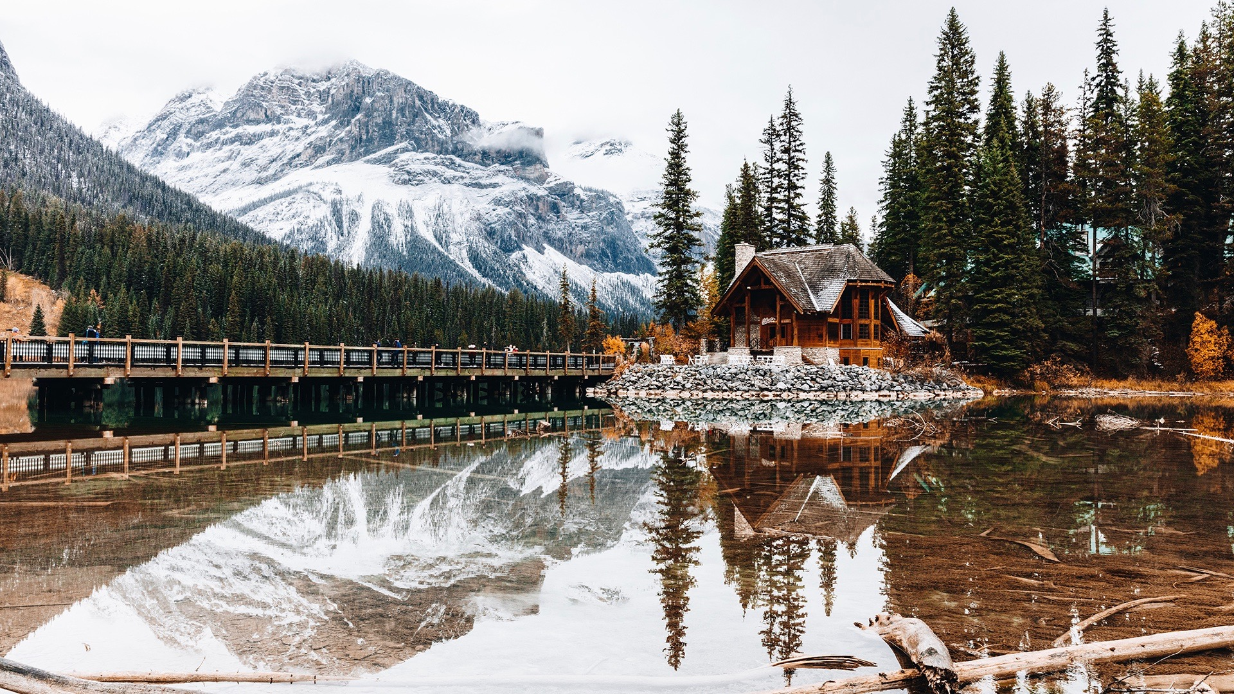
Labels:
Tree (Parents: Plant)
Plant
Nature
Fir (Parents: Tree, Plant)
Abies (Parents: Tree, Plant)
Outdoors
Housing (Parents: Building)
Building
Mountain (Parents: Outdoors, Nature)
Conifer (Parents: Tree, Plant)
Ice (Parents: Outdoors, Nature)
House (Parents: Housing, Building)
Countryside (Parents: Outdoors, Nature)
Shelter (Parents: Rural, Building, Countryside, Outdoors, Nature)
Rural (Parents: Countryside, Outdoors, Nature)
Water
Person
Human
Bridge (Parents: Building)
Snow (Parents: Outdoors, Nature)
Hut (Parents: Rural, Building, Countryside, Outdoors, Nature)
Mountain Range (Parents: Mountain, Outdoors, Nature)
Cottage (Parents: House, Housing, Building)
Pine (Plant, Tree)
Landscape (Parents: Outdoors, Nature)
Scenery (Parents: Outdoors, Nature)
Cabin (Parents: House, Housing, Building)
Panoramic (Parents: Landscape, Scenery, Outdoors, Nature)
Shack (Parents: Hut, Rural, Building, Countryside, Outdoors, Nature)

Slide 6
Filtering algorithm
If you look at the next slide, you will realize that Rekognition is capable of detecting lots of labels. However, having all of them in the description would make it less precise and often times quite vague.
For example, there are labels that are very general (ex. “Building”) and labels that are very precise (ex. “Shack”). I thought it would be more helpful to have a few labels that are very precise than a lot that are contradictory and vague.
To do that, I created a filtering algorithm. The next slide has a few of the rules that I created.

Slide 7
Filtering algorithm
case "reject an item":
case 1: do not add labels that are parents of items already in the list (ex. do not add "Plant" if there is "Tree" (Parent: "Plant") in the list)
case 2: do not add labels that have the same parents as an item already in the list (ex. do not add "Pavement" (Parent: "Path")
- ex. if "Sidewalk" (Parent: "Path" is already in the list)
!!! only exception: labels that have "Outdoors, Nature" as their parents (ex. add both "Ice" (Parents: Outdoors, Nature) and "Snow" (same))
case 3: if the label's parents are "Clothing" or "Accessories" (separate function for these)
!!! exception: if one of its parents is also "Person"
case "change an item":
if a new item is a child of an item that is already in the list (ex. delete "Plant" if "Tree" (Parent: "Plant") is trying to get in)

Slide 8
Problems
No publicly available table of what items have what parents
Poor categorization
labels that are not very descriptive (ex. "Weather")
labels that despite being "related" to each other do not share the same ancestor (ex. "Bag" (no parents) and "Handbag" (Parents: "Bag", "Accessories"))
labels that mean the same thing but are given different names for some reason (ex. "Person" and "Human", "Female" and "Woman", "Clothing" and "Apparel", "Accessory" and "Accessories").
etc

Slide 9
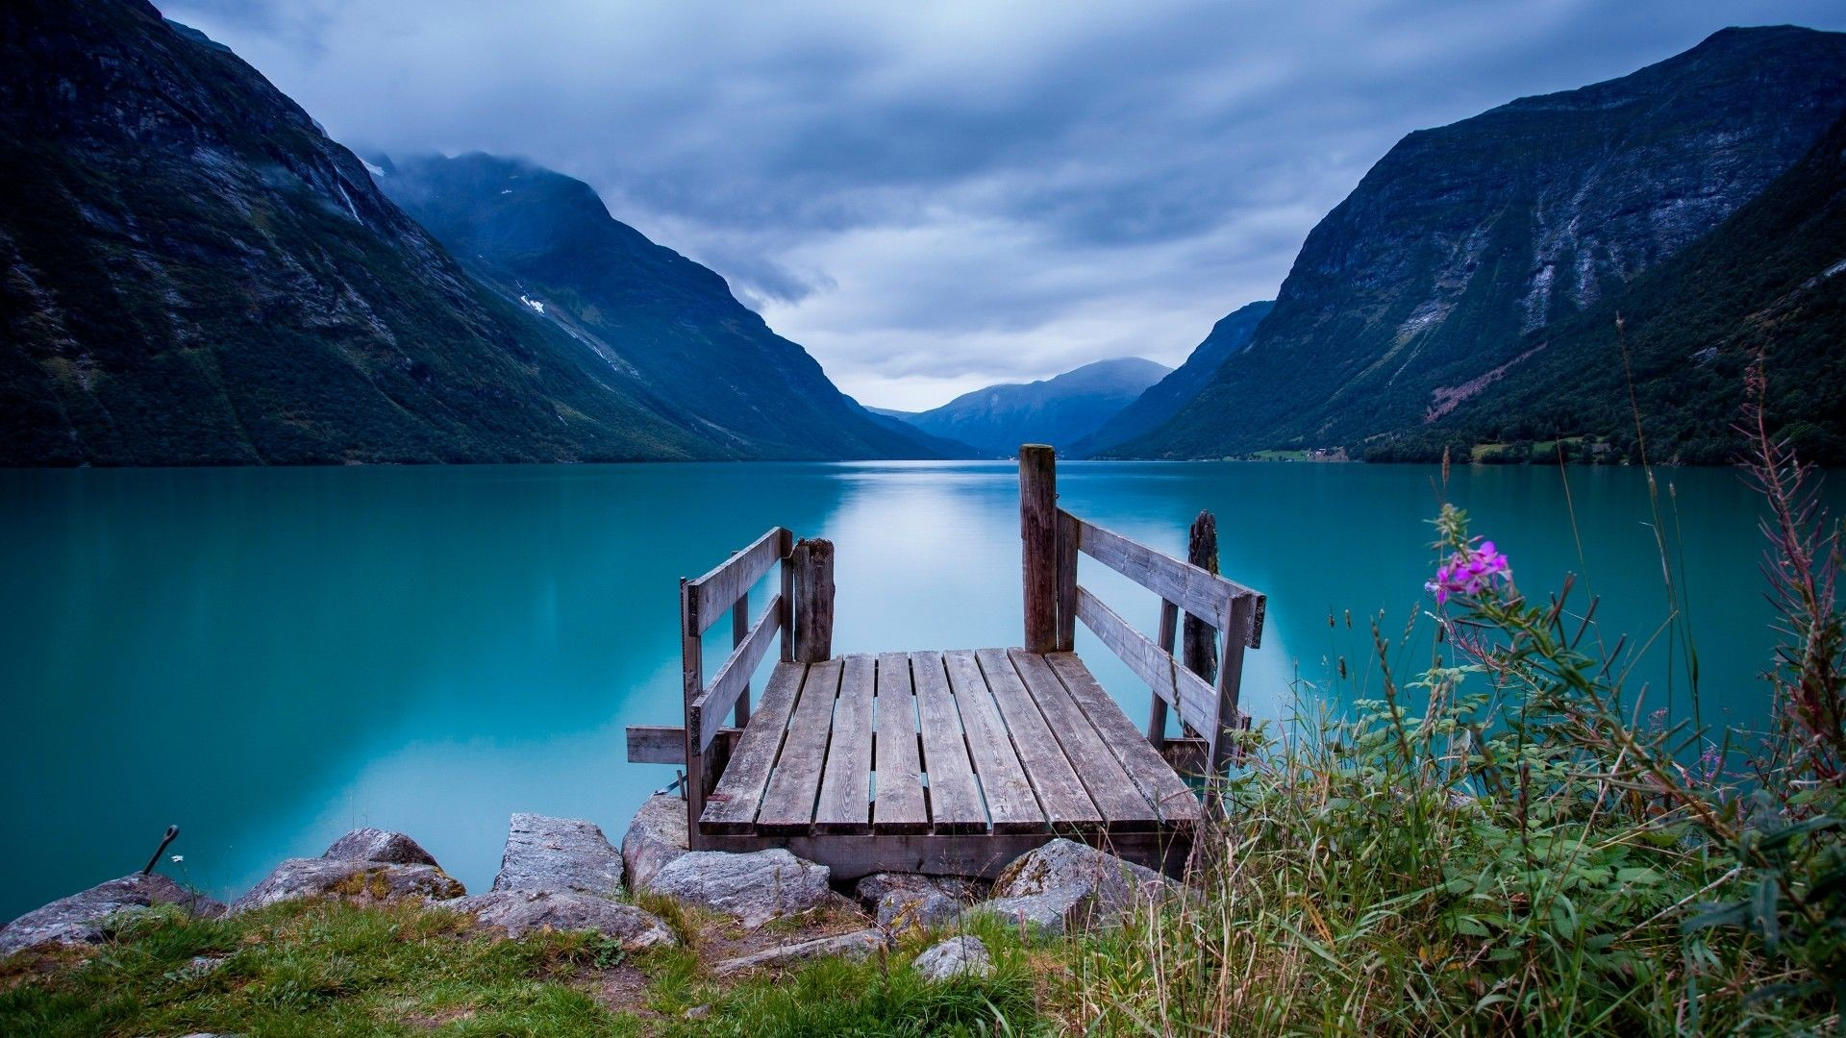
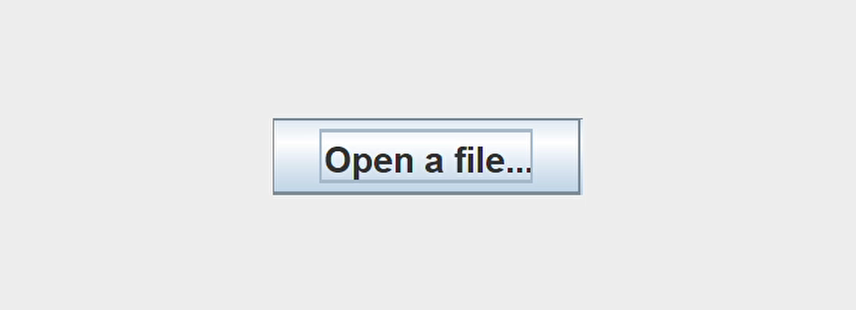
Results
Photo:
Description:

Slide 10
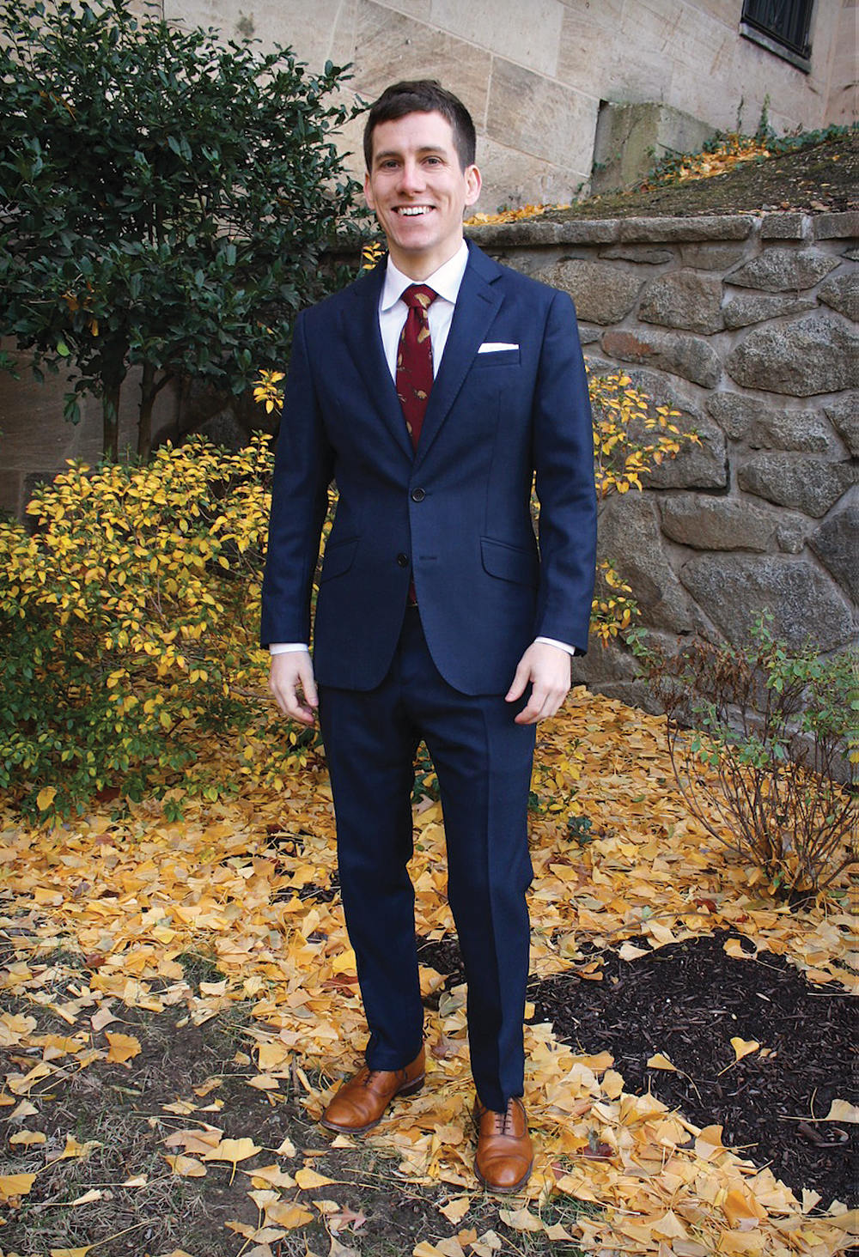

Results
Photo:
Description:

Slide 11
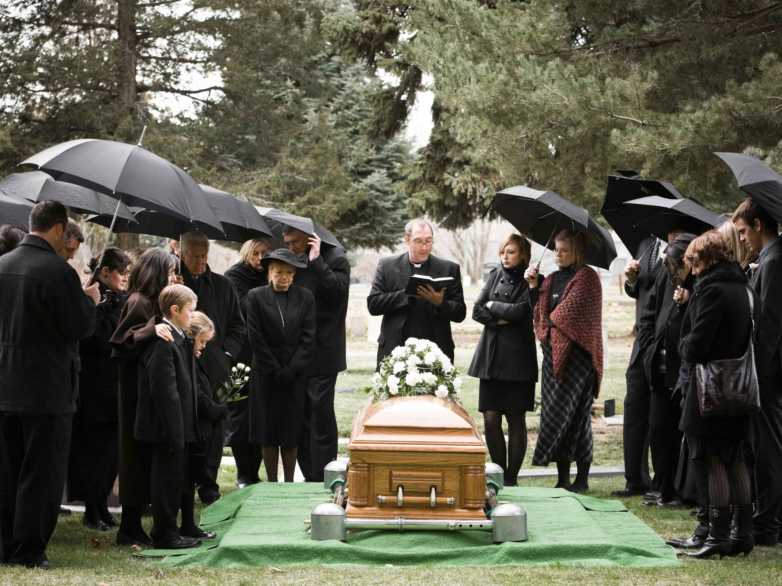
Results
Photo:
Description:

Slide 12
Thank you!

